Slide 1
Mastering (oop) using c++
✍Lecture :
Intro to oop
Ecabsolation
Inhertance
Polymorphysm
Complex class example
Lab : Exercise

Slide 2
✍ Structured Programming ?
Structured Programming :
Break the problem into a set of functions.
The main function will handle the communication between them .
Challenges in large programs
Transformation
Reusability
Maintainability
"Now let's see how OOP solves these problems."

Slide 3
✍Introduction to OOP
what is OOP ?
“OOP is a programming approach where a program is organized as a collection of interacting objects.”
How OOP Solves the Transformation Problem ?!
"Convert the problem to set of Units – Objects instead of functio“.
What is an Object?
"Object is a set of attributes (Data) and set of functions (behavior)“.
Attributes : Attributes describe what the object HAS.
Functions / Behavior : Methods describe what the object DOES.

Slide 4
✍Class vs Instance
Class
"A blueprint or template used to create objects".
Example : person , Animal
human : F_name ,L_name , birthdate , mail address , eat , send email , walk .
Animal : category , num_of_legs , eat , walk .
Features of OOP
Bottom-up approach in program design.
Programs organized around objects, grouped in classes.
Focus on data with methods to operate upon object’s data.
Interaction between objects through functions.
Reusability of design through creation of new classes by adding features to existing classes.

Slide 5
✍Features of OOP
Object-Oriented Programming has four main features:
Encapsulation
Polymorphism
Inheritance
Abstraction
"These features help us build software that is reusable, maintainable, and easier to manage.”

Slide 6
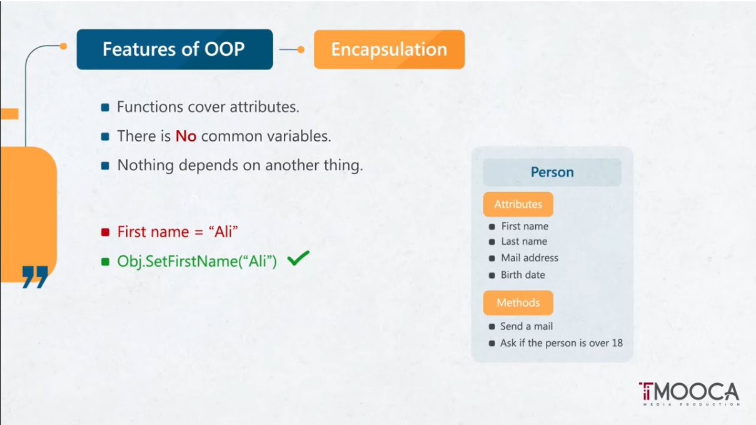

Slide 7
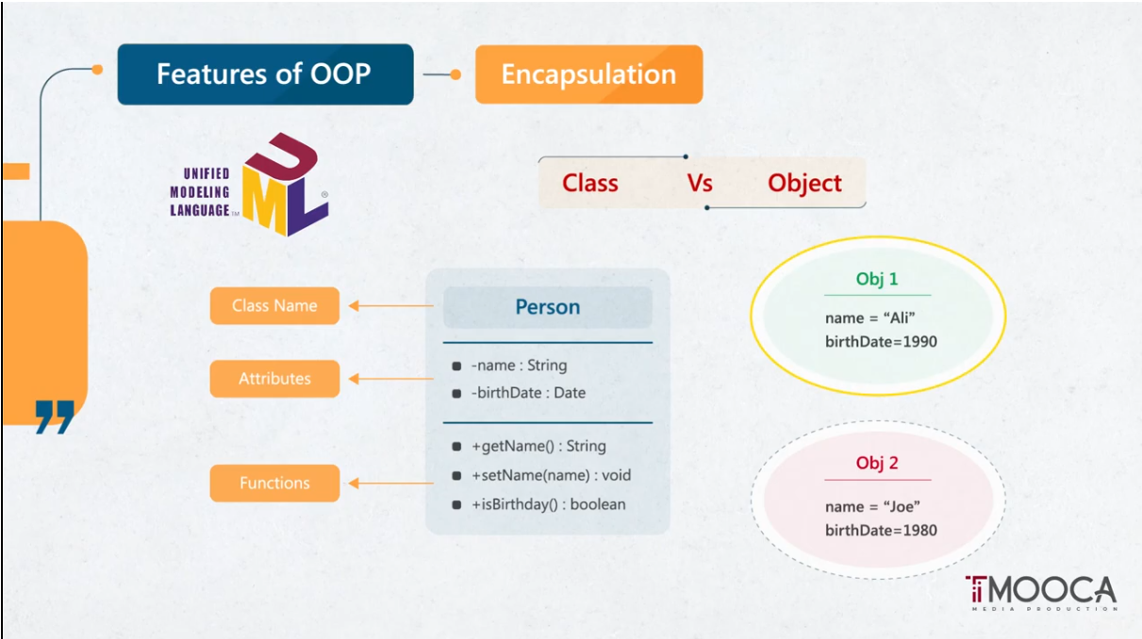

Slide 8
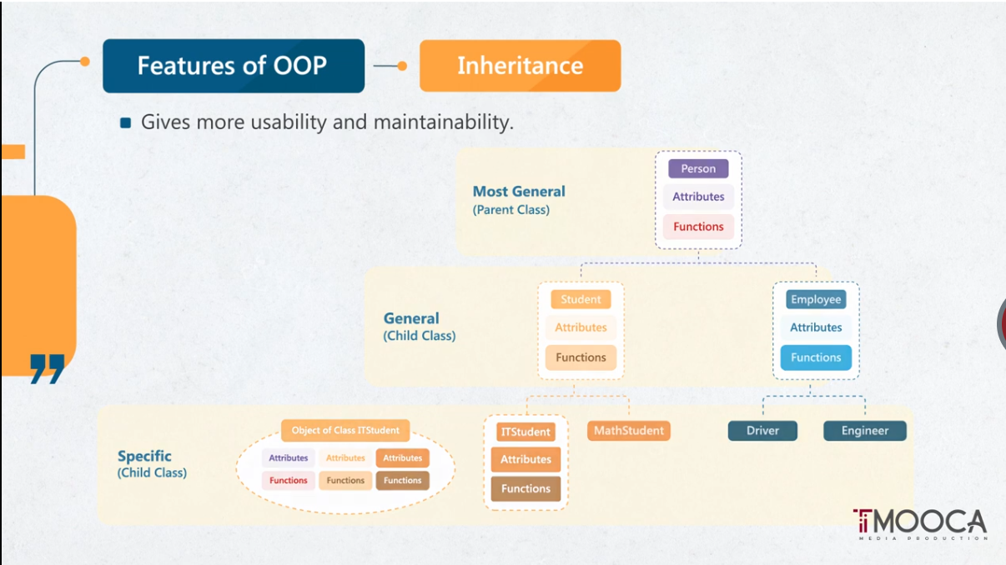

Slide 9
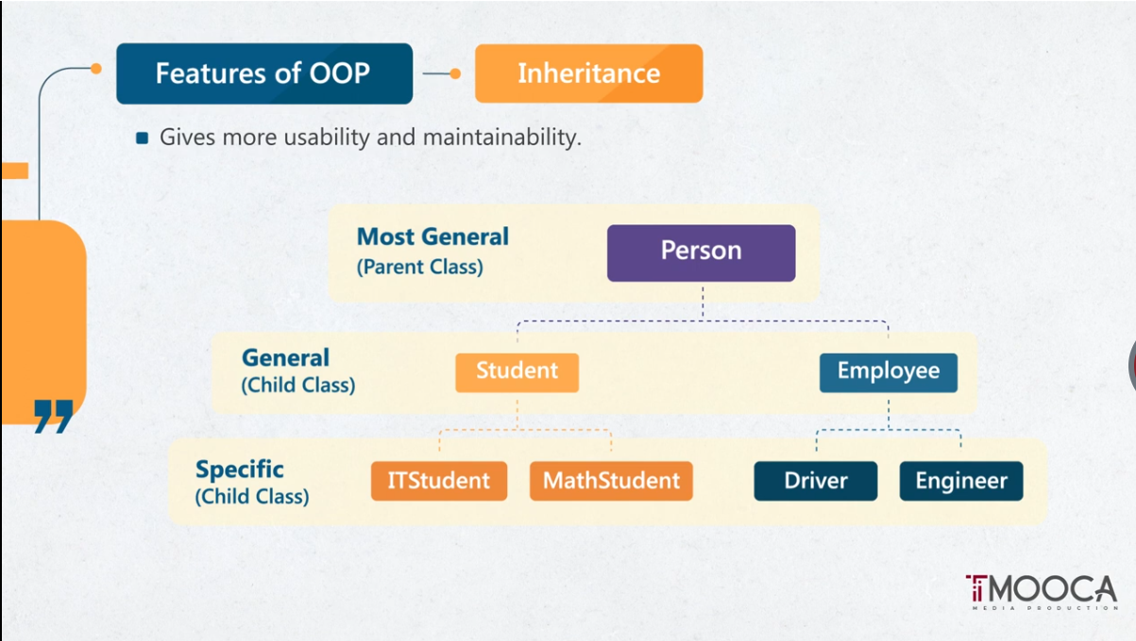

Slide 10
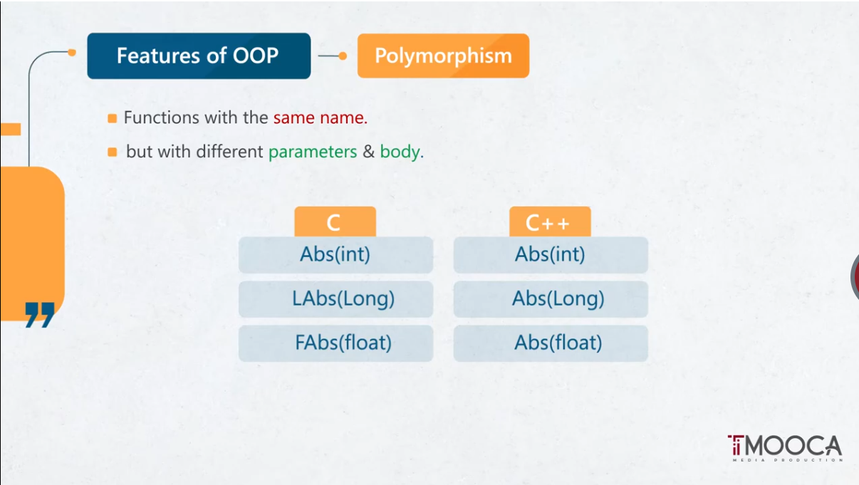

Slide 11
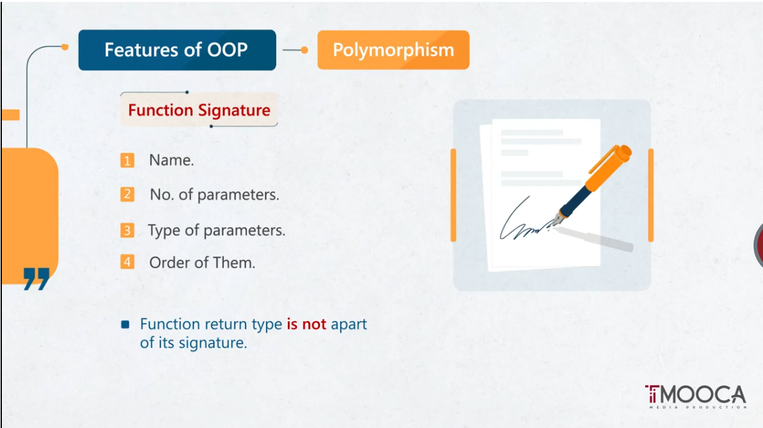

Slide 12
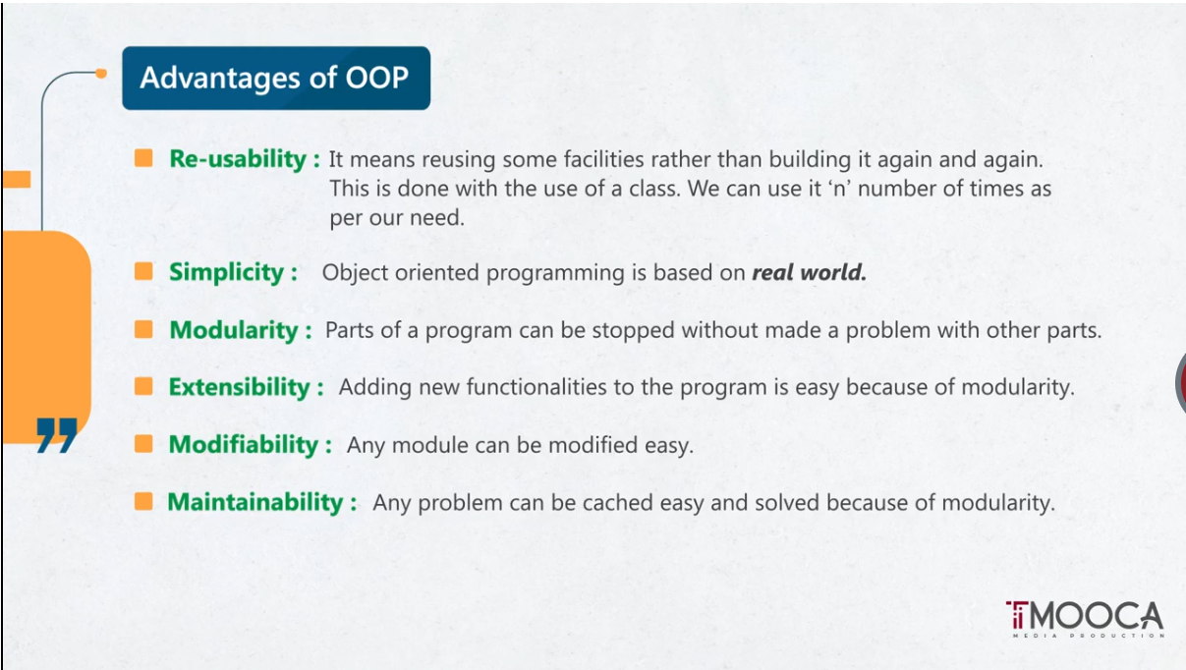

Slide 13
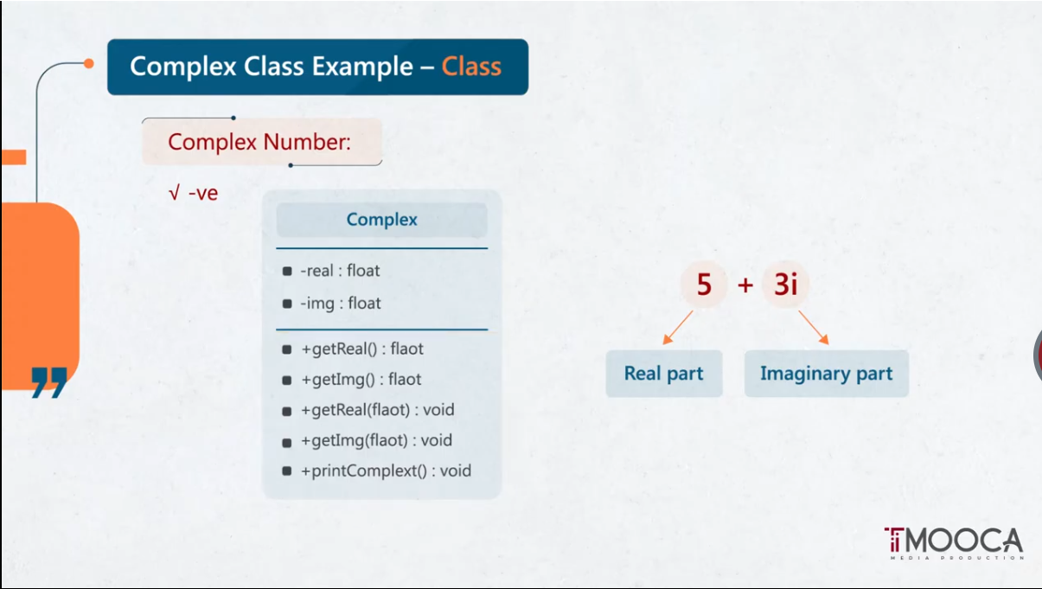

Slide 14
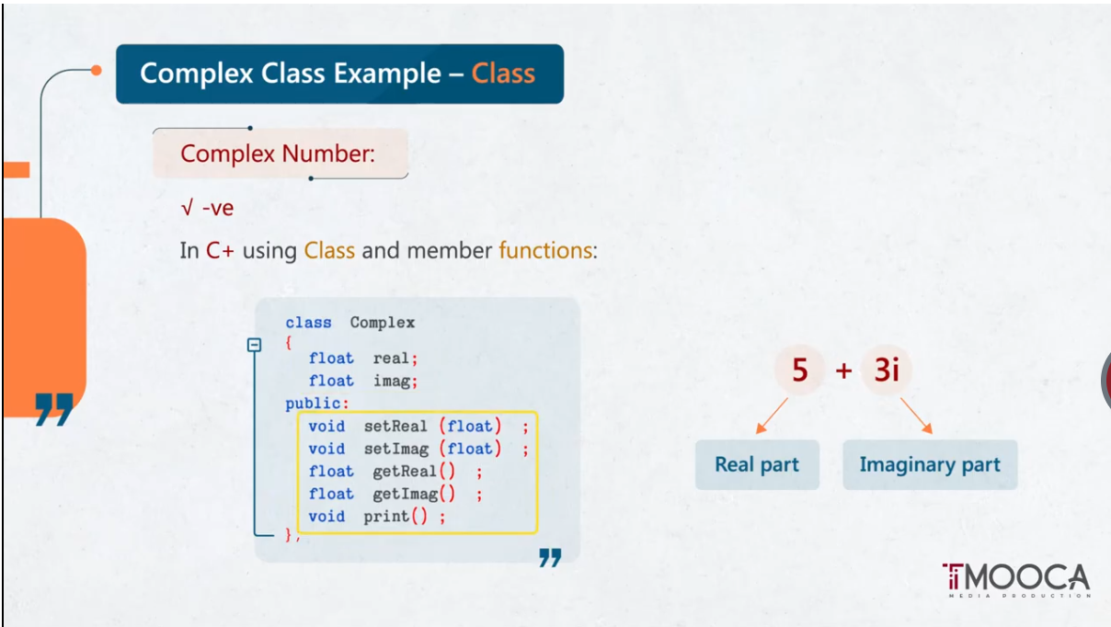

Slide 15
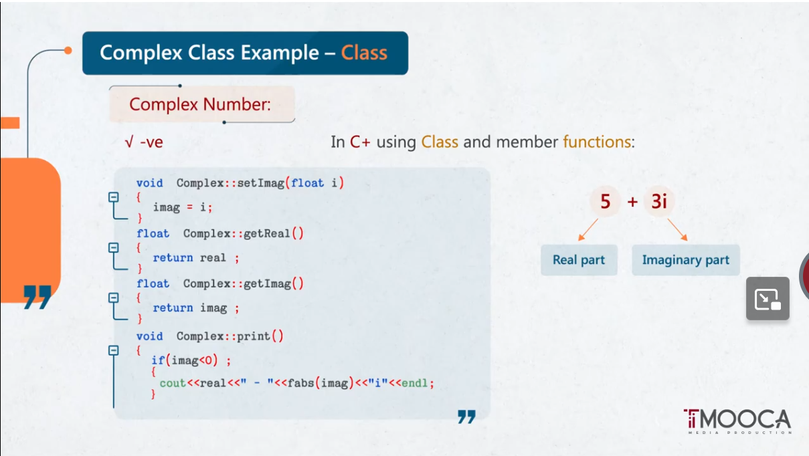

Slide 16
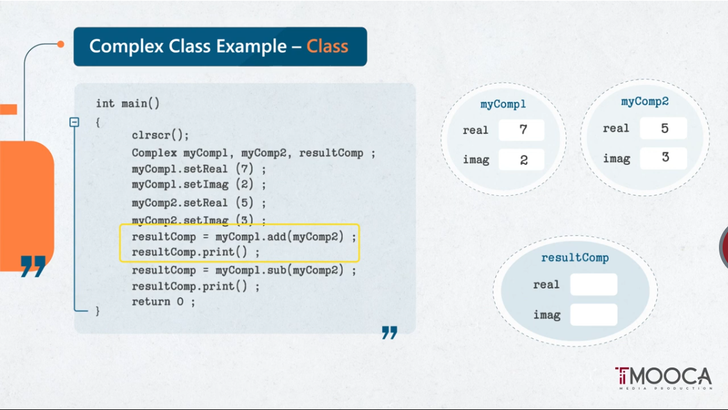

Slide 17
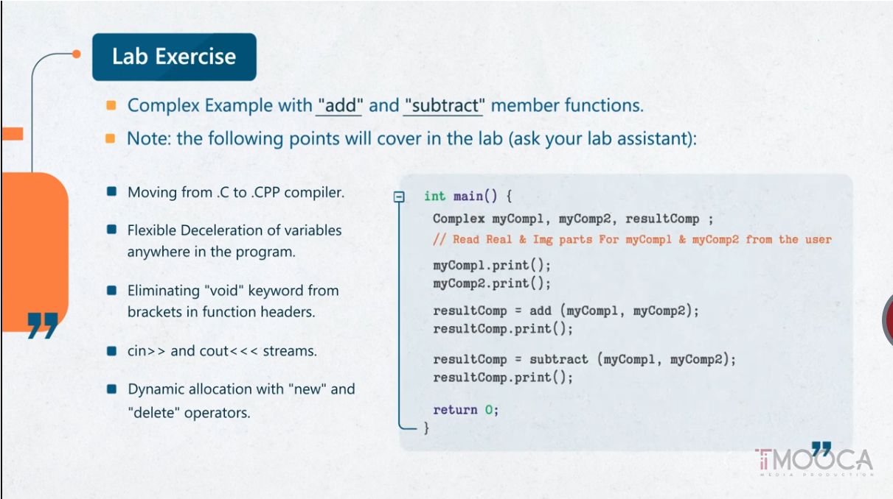

Slide 18
Thanks

